Slide 1
ORM’s

Slide 2
What’s an ORM do?
I need to get my objects into the database
ORM
objects
relational

Slide 3
Primary issues an ORM deals with
Mapping a class to one or more tables
Mapping properties to columns
Mapping inheritance hierarchy to one or more tables
CRUD on objects with all those maps
1:1, 1:M, M:1, M:N relationships
Dealing with object graphs and how much to load and when

Slide 4
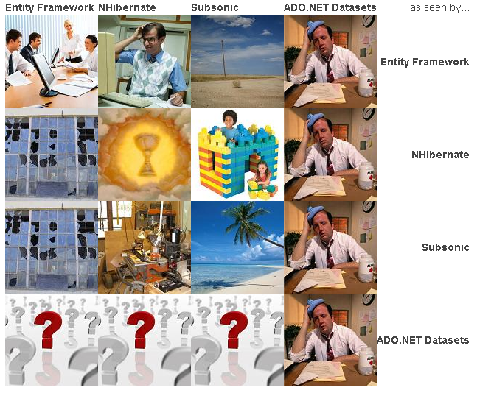
How each views the other

Slide 5
Models for ORM
Model | Characteristic
Code-First | Just take my C# objects and make a database from them
Database-first | Given a database, give me objects that let me access it without SQL
Model-first | I like UML – Create a database and objects from the model
This can be a religious battle
My opinion?
I believe in code-first
But database-first is usually how 98% of the reality
Model-first? Meh.

Slide 6
.NET ORM’s
Entity Framework
NHibernate
LINQ to SQL
Subsonic

Slide 7
We will look at the big-two…
EF
NHibernate

Slide 8
Models for both
NHibernate | Primarily database first, but can do code-first. 3rd party tools exist to do all three models
EF | Now support all three in VS.NET as of v6.0. But there are caveats to each. My $0.02? Database first is the best.

Slide 9
What we will examine in each
Some history and theory
Primarily database-first
How code-first can be used to create a database
How to map basic entities into database constructs
CRUD operations on classes
Navigating relationships
Lazy and eager loading

Slide 10
Onto the ORM’s

